Slide 1
Building Your Brand and the PIEP Biosketch
Andrew Green, PhD
UC Berkeley

Slide 2
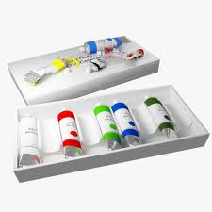
There is magic in the world
It transforms the mundane and inanimate objects

Slide 3
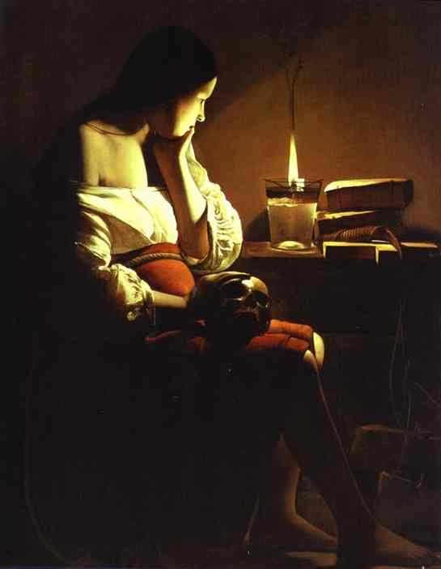
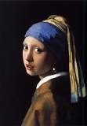
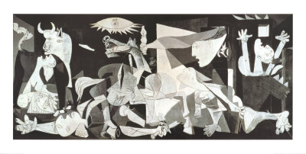
into

Slide 4
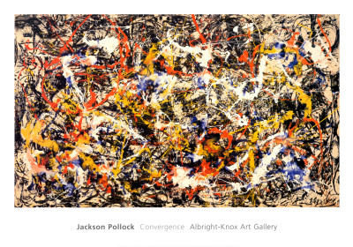
The Stuff of Life

Slide 5
Now I’m not calling postdocs inanimate objects, but sometimes their documents need some help coming to life

Slide 6
The specific focus of tonight’s presentation is the biosketch. But its really about the broader challenge of how you translate your skills, interests, and experience into a package that readily conveys your appeal to potential employers, or in this instance site visit hosts That is to build your brand

Slide 7
How the PIEP process works
The committee arranges for site visits
They solicit interest from eligible postdocs
They send bio sketches to the company
They make their selections
The biosketch, like your resume and cover letter in a job search, is the sole basis for their decision

Slide 8
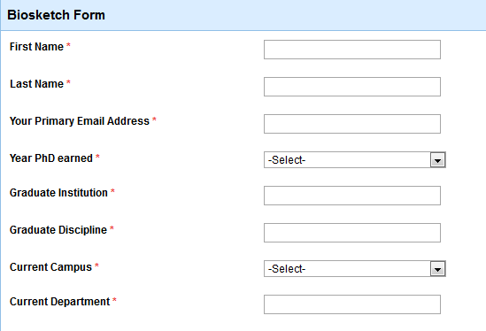
Demographic Info

Slide 9
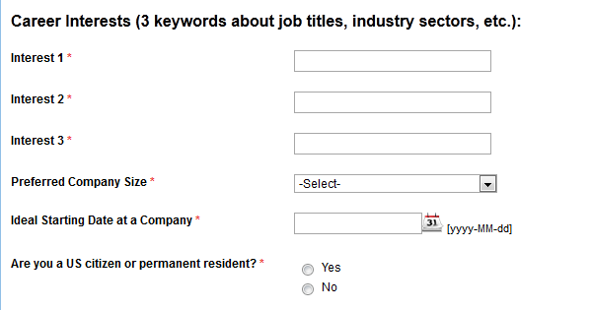
Learning to use their language

Slide 10
How do I differentiate you from others?
01234567890123456789 01234567890123456789 01234567890123456789 01234567890123456789 0123456789
“Proficient in Python” vs. “5 years of experience utilizing Python to analyze large data sets (>1 mil records) and creating fast algorithms to identify x.”

Slide 11
How do you choose what to highlight?

Slide 12
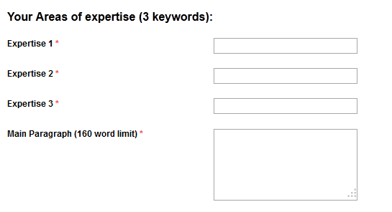

Slide 13
What do you think about the narrative below?
George W. Bush is currently a postdoctoral scholar appointed to the Energy Biosciences Institute (EBI) and advised by Hillary Clinton at UC Berkeley. Having earned a Ph.D. in molecular biology from Princeton University, and working with the EBI to improve microbial tolerance to biofuels, George wishes to move into a position that will allow him to combine his interest and experience in bench research with science policy, science outreach, investor relations, or public relations. George has become increasingly interested in making high-level scientific concepts accessible and engaging to the general public, the majority of which is composed of non-experts. He has also helped to organize events that share science with the public, such as a symposium to examine the way that the media portrays science, and the EBI’s showcase at the Cal Science and Engineering Festival that will inform the general population. George is enthusiastic about the prospect of learning more about career opportunities that exist in industry. (158)

Slide 14
How about this one?
I believe that without research and discovery the development of new innovative therapies and diagnostics for unmet medical needs will never be satisfied. Academic research is at the centre of revealing detailed mechanisms of disease that open up promising new avenues for treatment and detection of serious disorders. However, I am more attracted to the fact that Biotechs and Biopharmas are making major discoveries too and they are better equipped to capitalize and translate knowledge of disease mechanisms into effective new treatments and diagnostics. This is a really exciting time for me to explore career opportunities in the life sciences industry. I am a Post-doc at the University of California Berkeley and the Molecular Foundry at the Lawrence Berkeley National Lab. Prior to coming to Berkeley in July 2007, I did my graduate work at the University of Toronto. My research has been a multi-disciplinary endeavor that spanned molecular and cellular sciences to whole animal studies so my technical background is in electrophysiology, cellular imaging, mouse genetic engineering, antibody development, protein biochemistry, protein engineering, assay development and high-throughput screening. (179)

Slide 15
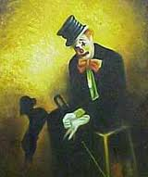
Kind of reminds me of this

Slide 16
My company has agreed to host a site visit
My job is to narrow down the list invitees
Am I going to devote a whole afternoon to the task?
What am I interested in? What is my mental checklist?
Most documents I see are written from the inside out.
You want your biosketch to be written as a response to what your audience cares most about

Slide 17
How do you accomplish this?
Speed Dating
Understand the sources of your value (project vs. skills)
Break down your contributions
Translate your credentials
Anticipate their key concerns; Showing not telling
Speak to the question, “Why are you here?”

Slide 18
Speed Dating
We live in an age of short attention spans
What are the 3 things you want me to know about you before I decide whether your application is worth more of my time.
This morning…
Have a friend interrogate you

Slide 19
The source of your value
1st Question I ask
Break down your roles and functions; have a friend interrogate you.
Postdoc – University of California, Berkeley
PI: Sam Castaneda, Rocket Science lab
Use Monte Carlo simulations programmed in C to calculate the impact of non-stochastic turbulence in re-entry trajectories
Develop fast algorithms to analyze postdoc funding in the year 2020 given a range of values associated with different rates of health insurance premiums increases.
Initiated inter-disciplinary, multi-site collaboration to analyze x
Led team in the creation and implementation of new lab safety protocols
Served as liaison to outside vendors
Trained and mentored 3 undergraduates and 2 graduate students
Selected to give presentations at 5 major, scientific conferences
Deliver presentations on Rocket Science to lay audiences at Cal Day and during visits to local area Middle Schools
Serve as member of the PIEP Advisory Board
Perform outreach to companies as potential host sites
Organize 8 week speaker series
Pay off speakers from VSPA slush fund

Slide 20
Translate your credentials
TA Bio 1A
GSR vs Editorial Assistant

Slide 21
Anticipate their key concerns; Showing not telling
Do you play well with others?
Can you multi-task?

Slide 22
Speak to the question, “Why are you here?”

Slide 23
Your biosketch
Is a hybrid document: a cross between a resume and cover letter
Is concise (95 characters and 160 words)
Reflects an implicit dialogue between you and your audience.
Allows for the most critical information to be easily assimilated

Slide 24
If your interested in a non-bench role
What do you want them to know about you?
How do you convey skills in administration, project management, communication, etc.
Don’t tell, show.

Slide 25
This seems like a lot of work, why bother?
It’s about more than creating a document
PIEP’s site visits and networking events offer unparalleled opportunities to:
Learn about the specific and more general aspects of organizational cultures and management styles within Biotechs
Better understand their language and terminology
Discover what “soft skills” are seen as valuable
Identify science-based career paths with trajectories from the bench

Slide 26
Building Your Brand
Pulling from your extensive inventory of skills and experiences
Focusing the readers attention on the specific sub-set of the above most relevent to their needs/decision
Translating and delivering that information in a clear and concise manner (whether in a cover letter, a biosketch, a LinkedIn profile, etc.) that helps them project you into the role for which you have applied

Slide 27
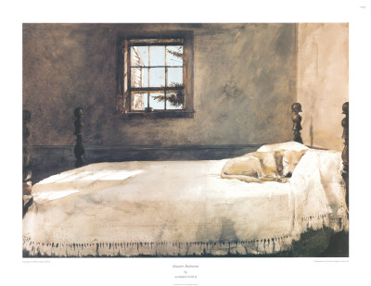
I see a lot of this: quiet & clichéd

Slide 28
Lets make it bright and energetic

Slide 29
Questions?

