Slide 1
PIEP Workshop on
Non-Academic Postdoctoral Training Programs
September 26, 2013

Slide 2
Speaker:
Chuck Voliva
Director of Cancer Biology
Novartis
September 26, 2013

Slide 3
NIBR Postdoctoral Program
Chuck Voliva
Director Cancer Biology

Slide 4



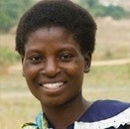

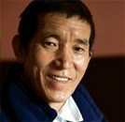
Our focus is on patients
Our purpose is to care and cure
Novartis products protected or treated
1.2 billion patients around the world in 2012

Slide 5

Fortune – World’s Most Admired Companies 2013
Novartis is #1 in the healthcare sector for the third year straight
Most admired pharmaceutical companies
2013 | 2012 | 2011
1 | 1 | 1 | Novartis
2 | 4 | 2 | Merck
3 | 2 | 4 | Abbott
4 | 5 | 3 | J&J
5 | 6 | 7 | Roche
6 | 7 | 6 | GSK
7 | 8 | 5 | Amgen
6.43
6.41
6.27
6.21
6.14
6.00
5.94
Methodology: As per evaluation of more than 60 senior pharmaceutical industry executives and financial analysts on a scale from 0 (poor) to 10 (excellent) on nine criteria (community/environment, financial soundness, globalness, long-term investment, innovation, management quality, people management, products/service quality and use of assets).

Slide 6
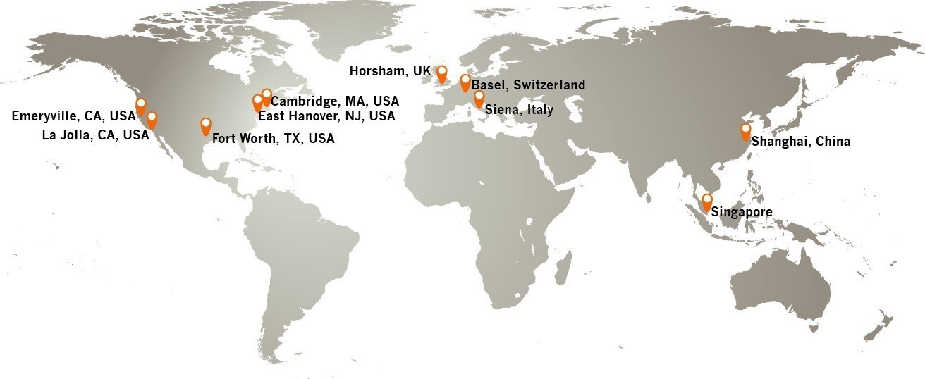
Novartis Institutes for BioMedical Research (NIBR)
A global network of 7,000 scientists, physicians, and business professionals.
United States
Cambridge, MA
East Hanover, NJ
Emeryville, CA
La Jolla, CA (GNF)
Fort Worth, TX (Alcon)
Europe
Basel, Switzerland
Horsham, UK
Siena, Italy (NVGH)
Asia
Shanghai, China
Singapore (NITD)

Slide 7
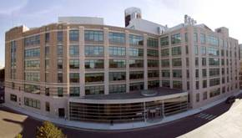



Novartis Institutes for BioMedical Research (NIBR)
Transforming drug discovery
Unique research strategy driven by patient needs
Intensifying focus on molecular pathways shared by various diseases
Integration of clinical insights with mechanistic understanding of disease
Research-to-Development transition redefined through fast and rigorous “proof-of-concept” trials
Strategic alliances with academia and biotech strengthen preclinical pipeline
Cambridge global NIBR headquarters

Slide 8



NIBR Research Strategy: Focusing on Greatest Patient Need and Scientific Promise
High
Best
Therapeutic Projects
Unmet
Medical
Need
High
Understanding of Disease Mechanism

Slide 9

NIBR Disease Areas
Autoimmunity,
Transplantation &
Inflammation
Oncology
Cardiovascular &
Metabolism
Neuroscience
Respiratory
Diseases
Infectious Diseases
Musculoskeletal
Ophthalmology

Slide 10
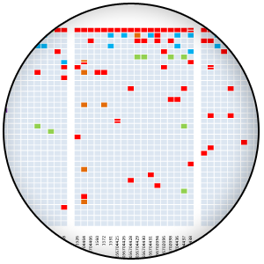
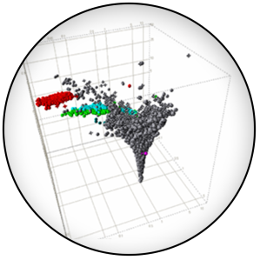
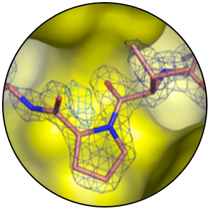
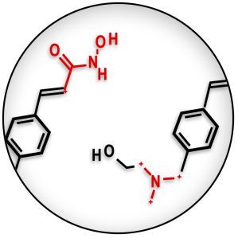


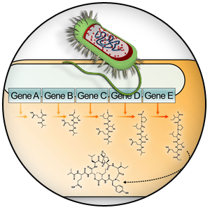
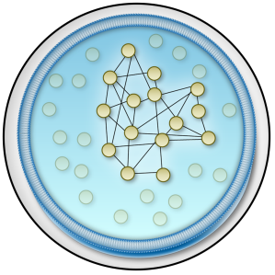
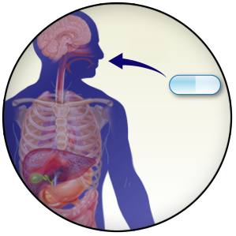
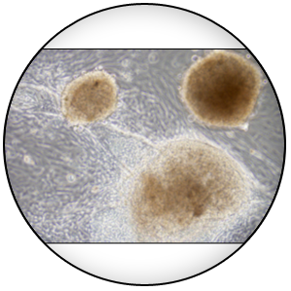
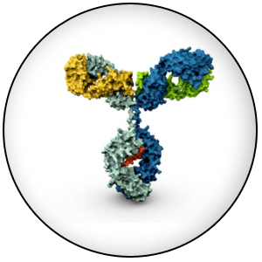
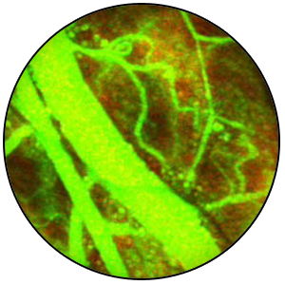
Each Project Draws from Global Core Competencies
These resources strengthen our program
NextGen Sequencing
Bio-informatics
Chemistry
Preclinical Safety, DMPK
Genetics
Project
Synthetic Biology
Pathways
Stem Cells/
Regenerative Medicine
Translational Medicine
Biologics
Imaging

Slide 11
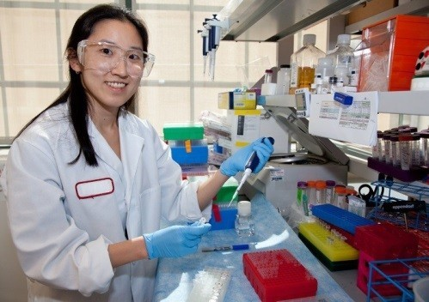
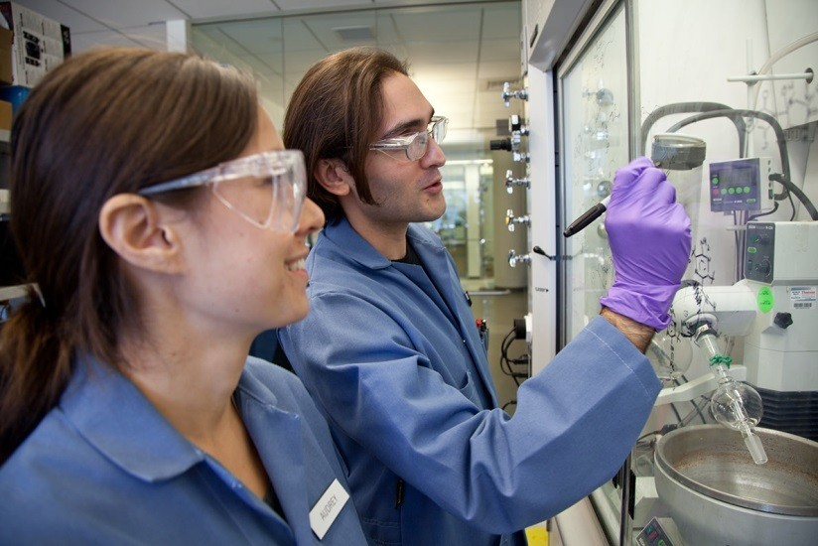
NIBR Postdoctoral Program Objectives
Support innovative, publishable, basic research that addresses important scientific questions, furthers mechanistic understanding of disease, and enhances drug discovery efforts
Provide opportunities for scientific and career development to prepare fellows for their next step in academia or industry
Continue to build a diverse and inclusive program that brings together excellent postdocs, mentors, and projects
Partner with academic centers of excellence

Slide 12
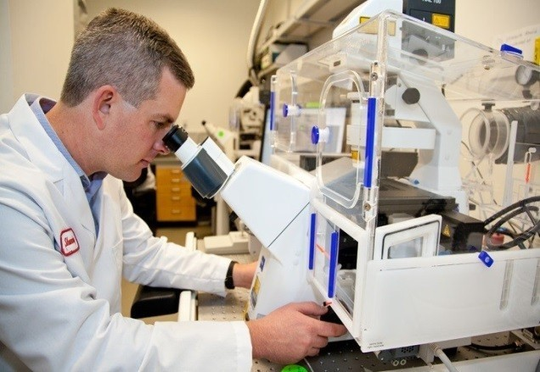
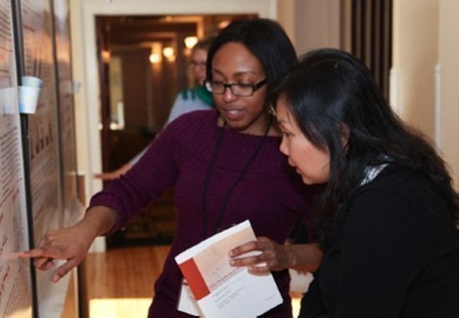
What do we look for in postdoc candidates?
Solid scientific background in almost any area – molecular and cell biology, biochemistry, chemistry, mouse models, computational sciences, pharmacology, etc.
Strong critical abilities
Scientific vision
Passion for science
Eligibility
  PhD students within one year of completing their thesis work
  Postdoctoral scholars with fewer than 2 years of research experience past the PhD

Slide 13
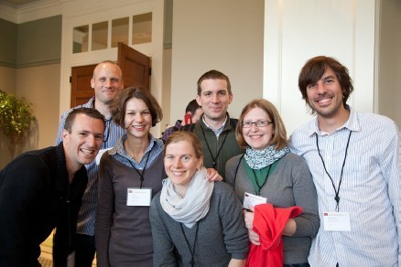
NIBR Postdoctoral Program Overview
Up to 4 year term
NIBR mentor + Academic advisor
Scientific seminars: 1-3/week
Postdoctoral seminar series: 1-2/month
Attend external scientific conferences
Postdoctoral Research Days
Workshops (presentation skills, career development, etc)
Individual Development Plan (optional)
To apply: http://nibr.com -> Postdocs -> Application process

Slide 14
NIBR Postdocs Contribute High-quality Publications
Other publications at: http://nibr.com/postdocs/publications/index.shtml
Pim2 is required for maintaining multiple myeloma cell growth through modulating TSC2 phosphorylation.
Lu J, Zavorotinskaya T, Dai Y, Niu XH, Castillo J, Sim J, Yu J, Wang Y, Langowski JL, Holash J, Shannon K, Garcia PD.
Blood. 2013 Aug 29;122(9):1610-20.
Identification of NUB1 as a suppressor of mutant Huntington toxicity via enhanced protein clearance.
Lu B, Al-Ramahi I, Valencia A, Wang Q, Berenshteyn F, Yang H, Gallego-Flores T, Ichcho S, Lacoste A, Hild M, Difiglia M, Botas J, Palacino J.
Nat Neurosci. 2013 May;16(5):562-70.
RAF inhibitors activate the MAPK pathway by relieving inhibitory autophosphorylation.
Holderfield M, Merritt H, Chan J, Wallroth M, Tandeske L, Zhai H, Tellew J, Hardy S, Hekmat-Nejad M, Stuart DD, McCormick F, Nagel TE.
Cancer Cell. 2013 May 13;23(5):594-602.
A unique herpes viral transcriptional program in KSHV-infected lymphatic endothelial cells leads to mTORC1 activation and rapamycin sensitivity.
Chang HH, Ganem D.
Cell Host Microbe. 2013 Apr 17;13(4):429-40.
Modeling vemurafenib resistance in melanoma reveals a strategy to forestall drug resistance.
Das Thakur M, Salangsang F, Landman AS, Sellers WR, Pryer NK, Levesque MP, Dummer R, McMahon M, Stuart DD.
Nature. 2013 Feb 14;494(7436):251-5.

Slide 15
Postdoc Alumni Data (2007-present)
Where do postdocs go immediately after their term at NIBR?

Slide 16
Application Steps
Typically 3-4 months total
View mentor
profiles and
apply*
CV Review
Phone
Interview
On-site
Interview
Outcome
Develop
Project
  *Candidates apply to mentors indicated as having a “Postdoctoral Position Available”
~2 weeks
Variable
< 3 weeks
Within 3 months of start
To apply: http://nibr.com -> Postdocs -> Application process

Slide 17
Potential Mentors in Emeryville
Prospective Mentors | Department
Dino Mavrakis | Cancer Biology
John Langowski and Jocelyn Holash | Pharmacology and Translational Biology
Mallika Singh | Pharmacology
Tatiana Zavorotinskaya | Cancer Biology
Mohammad Hekmat-Nejad | Biochemical Lead Discovery
Visit http://nibr.com/postdocs/index.shtml web page soon to view all available positions

Slide 18
Questions

Slide 19
Speaker:
Yi-Chun Maria Chen
Postdoctoral Researcher
Genentech
September 26, 2013

Slide 20
Genentech Postdoc Program
The Berkeley Postdoc Industry Exploration Program (PIEP)
by Yi-Chun Maria Chen
Sep 26, 2013

Slide 21
The Mission
Emphasize on basic and fundamental discovery research.
Provide second-to-none resources in areas ranging from structure determination to mouse genetics to make for an exceptional environment.
Conduct first-rate science.
Publish in top-tier journals.

Slide 22
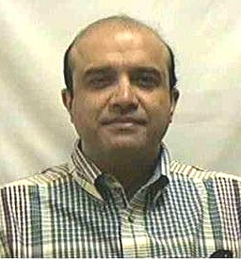
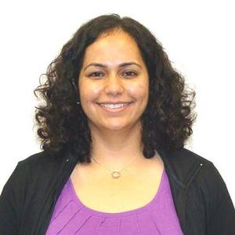
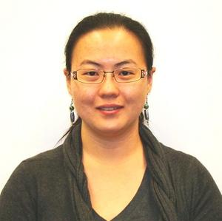
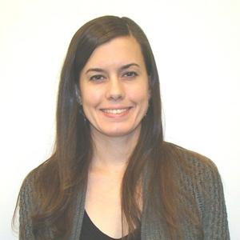
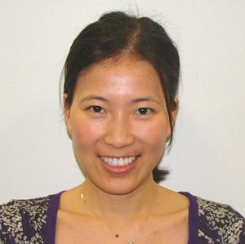
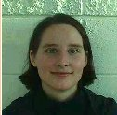
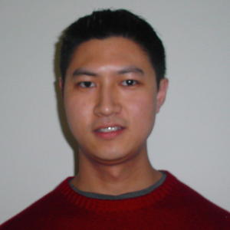
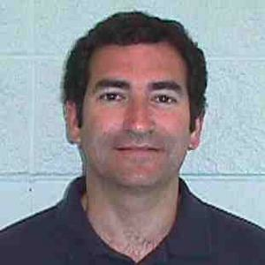
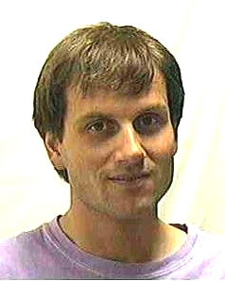
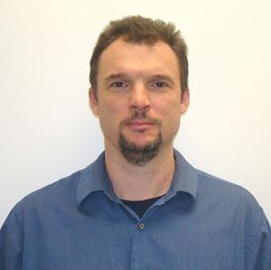
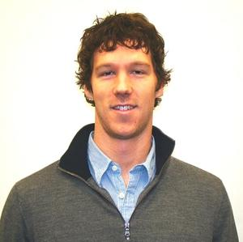
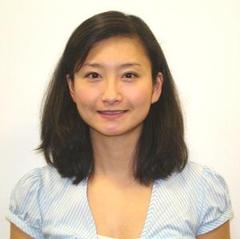
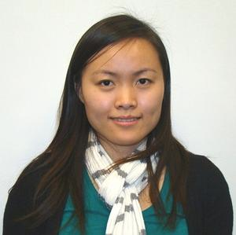
Current Structure
Dr. Vishva Dixit
Program Director
Postdoc Committee:
PD Faculty
Committee:
Sarah Hymowitz
Kevin Leong
Paul Polakis
Menno van Lookeren
Domagoj Vucic
Shivani Ahuja
Yi-Chun (Maria) Chen
Courtney Easley-Neal
Chunyan Gu
Sam Nalle
Rebecca Sheng
Yizhou Zhou

Slide 23
PD and Mentors

Slide 24
Publications
4
5
4
5
3
# of Publications
2
1
3

Slide 25
Regular Activities
Annual Offsite Meeting
Attended by research directors and science VPs, the scientific program includes a keynote speaker from outside of Genentech and postdocs present their work.
Onsite Postdoctoral Meetings
Held twice monthly, two postdocs present their latest research at each meeting.
Postdoc Seminar Series
As part of an annual seminar series, postdocs invite and host 10 to 12 speakers of their choosing.
Career Day
Scientific Workshops
Pilot Plant Tours
New PD Orientations
External Conference (Domestic or International)

Slide 26
Resources
Postdoc internal website:
  Alumni contacts
  401K info
  Benefits
Genentech core facilities
Genentech internal meeting
Nextgen Leadership Forum
gWISE meetings
Linkedin group: “Genentech Postdocs and Alumni”
NYAS membership

Slide 27
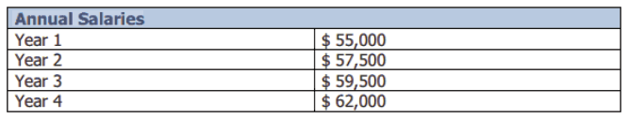
Benefits
Medical, Dental, and Vision
Life and Disability Insurance
401(k)
12 Paid Holidays
Vacation Time (3 Weeks)

Slide 28
GNE Postdoc Alumni Statistics
Data Set:
275 former GNE postdocs
Exit date range = 1998-present (w/ updates)
Data inputs = postdoc tenure, department, mentor, current employer name and position, current contact, previous employer name and position (if applicable)

Slide 29
Alumni Professions by Field

Slide 30
Overall Employers of Alumni
62
Number of Former postdocs
11
8
7
7
5
4
4
4
4
The rest of 159 PDs (58%) are employed by institutions with ≤3 former postdocs.
Genetech PD alumni are in a diverse group of employers.

Slide 31
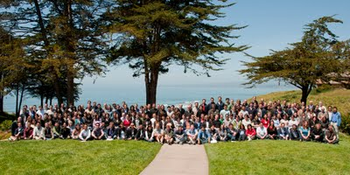
Thank you!!
http://www.gene.com/careers/academic-programs/postdocs

Slide 32
Speaker:
Michael Armbrust
Postdoctoral Researcher
Google
September 26, 2013

Slide 33
Speaker:
Jake Klamka
Founder
Insight Data Science Fellowship Program
September 26, 2013

Slide 34

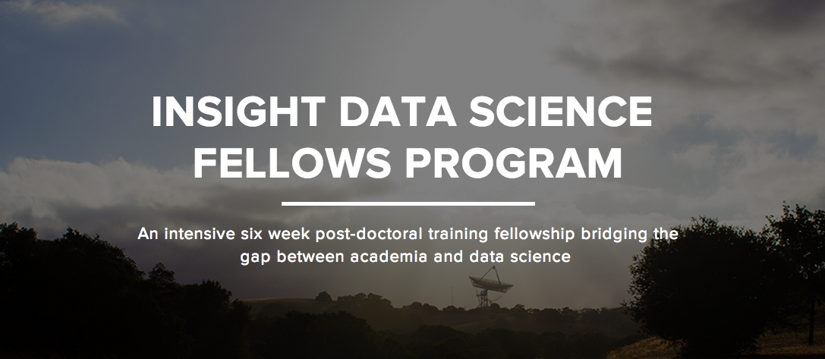
insightdatascience.com
Jake Klamka
jake@insightdatascience.com

Slide 35

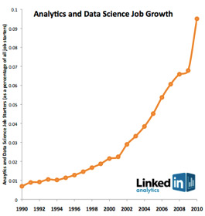

Slide 36

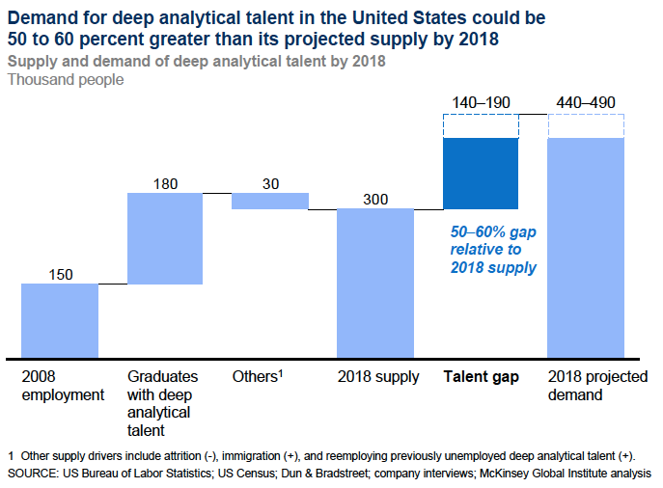

Slide 37

“The best data scientists tend to be ‘hard scientists,’ rather than computer science majors.”
- DJ Patil

Slide 38



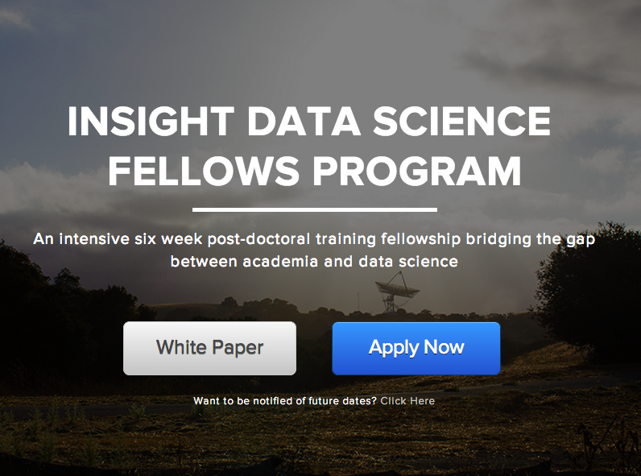
insightdatascience.com

Slide 39

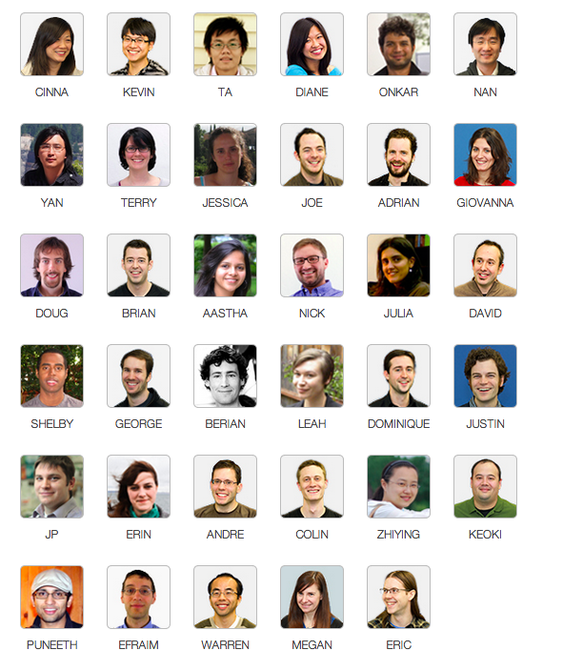
Insight
Fellows
are
Quantitative
PhDs & Postdocs
transitioning to careers in Data Science

Slide 40

Insight educates the next generation of leading
Data Scientists.

Slide 41

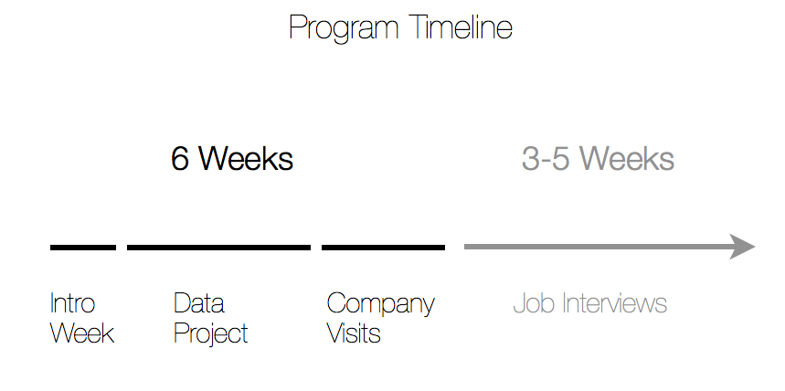

Slide 42










Insight Fellows are Data Scientists at:
and many other top data-driven companies

Slide 43


insightdatascience.com
jake@insightdatascience.com
Upcoming Sessions:
January 6, 2014 (applications open)
June 2014
September 2014

