Slide 1
“Current and Future Trends in Industry”
“White Biotechnology”
September 27th, 2012
Stan Mainzer
DuPont Industrial Biosciences

Slide 2
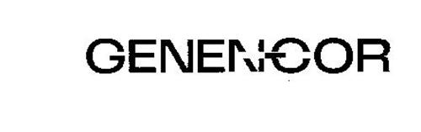






Who is DuPont Industrial Biosciences?
1982 to 2012: 30 years of industrial biotechnology
Genentech
&
=
&
&
DuPont Industrial Biosciences

Slide 3
What is Industrial or White Biotechnology?
“The application of biotechnology for industrial applications…” (Wikipedia)

Slide 4



Key Market Segments in Our Business
Agriculture and Nutrition
Industrial Biosciences
Advanced Materials
Products
End use markets
Bioactives
Enzymes, proteins, peptides
Food and beverages, feed, cleaning, paper, personal care
Bioactives
Biomaterials
Biomaterials
Core
Biorefineries
Biochemicals
Biomaterials
Carpet, textiles, automotive
Biorefineries
Ethanol
Biobutanol
Bioprocessing aids
Fuels, carbohydrates
Core Elements
  Renewable, biobased inputs
  Design and operation of cell factories
  Deliver enhanced process and product sustainability
Notes:
Advancing to slide #3 you can see we’ve organized our business around three BioBased segments that we call Bioactives, Biomaterials, and Biorefineries. We think these names do a great job of describing their mission within the business, help us segment our customers and our markets, and allow us to leverage common capabilities and approaches to serving our customers within these segments.
The first, Bioactives, is focused on bioactive enzymes that play an important role in animal nutrition, food processing, fabric and household cleaning, and personal care. Examples here are feed enzymes that allow animals to more efficiently convert agricultural inputs into protein, detergent enzymes that allow you to remove those tough stains from clothing while preserving the fabric’s color brilliance, or baking enzymes that extend shelf life of bread. Application development, extending our geographic reach and a pipeline of new products will fuel growth in this area.
The 2nd category includes Biomaterials and Biochemicals like the Sorona polymer I mentioned earlier. A great example here is Sorona based SmartStrand products sold by Mohawk industries – the world’s largest residential carpet manufacturer. This biobased product provides a more sustainable route to carpet fiber. Derived from sugar, it delivers a lower cost product than the petroleum based option, and offers unique performance attributes that you cannot get from any other fiber. Having all three of these attributes, renewably sourced, lower cost, and differentiated properties is what it takes to win in this segment.
The 3rd category are products that enable the further processing of sugars into fuels such as ethanol today, and butanol in the future, as well as carbohydrates needed by the food and beverage industry. Conversion of biomass to sugars is the basic core mission here. As our cellulosic technology moves forward we now have three revenue streams. - Licensing of engineering design & technology, sales of biofuels, and sales of merchant enzymes that will be used by all of these new plants for their operation.
I’d like to highlight another important point – even though these three segments are very different in their end market focus, there are some very common core elements that link them together and that can be highly leveraged across all three. The first is the fact that they all begin with renewable feedstocks. Whether it’s dry ground corn for Butanol production in the Midwest, or starch to dextrose from a sugar mill in Tennessee for our Sorona polymer, or the sugars for enzyme fermentation for our detergent enzymes in your laundry detergent – they all start with production agriculture. A second element - these innovations rely on our ability to design and operate cells as factories. We like to say we don’t have a few manufacturing sites around the world, we actually have Billions of factories - everyday billions of cells produce the products that we sell. It’s an important differentiator for us. Any boutique laboratory can create a single cell or protein that in a controlled environment can produce wonderful and novel products. But doing that on an industrial scale, in varying conditions, at a cost that is economic for your customers…that’s the thing that separates DuPont from most of the other companies in this space. Finally our solutions provide process and product sustainability for our customers, and for us.

Slide 5
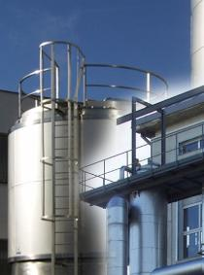
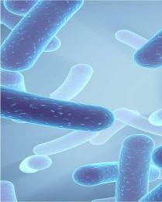
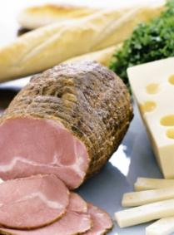
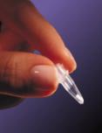
DuPont Nutrition & Health
Industry Leading Science
Processing
Biotechnology
Health
Application
Immune
Digestive
Heart
Weight
Bone
Oral
Sports
  Extraction
  Conversion
  Separation
  Genomics
  Molecular biology
  Fermentation
  Nutrition science
  Immunology
  Microbiology
  Food science
  Formulation knowledge
  Sensory science
5
Notes:
Like all other DuPont businesses, the DuPont Nutrition & Health business is driven by our advanced technologies and capabilities.
5

Slide 6
Focused on Three Biobased Segments
Serving a diverse set of customers
Carbon Sources
Conversion
Biobased Products
End use markets
Bioactives
Enzymes, proteins, peptides
Food and beverages, feed, cleaning, paper, personal care
Our Competitive Advantage
Starch
Biomaterials
Bio/chemical
transformation
Bio/chemical
transformation
Sugars
Biochemicals
Biomaterials
Carpet, textiles, automotive
Biomass
Biorefineries: Biofuels
Ethanol
Biobutanol
Bioprocessing aids
Fuels, carbohydrates
Notes:
Shifting to SLIDE 4- As an integrated biobased business, we are focused across the value chain —accessing low cost, sustainable sources of carbon like corn starch or biomass residue, and converting them to basic sugars that can be further processed into bio-products for our customers. In other words, Sugar becomes our new oil. We have a substantial competitive advantage in our technology for the production of these sugars, and the transformation of these sugars into bio-based products.

Slide 7

Bakery Enzymes

Slide 8
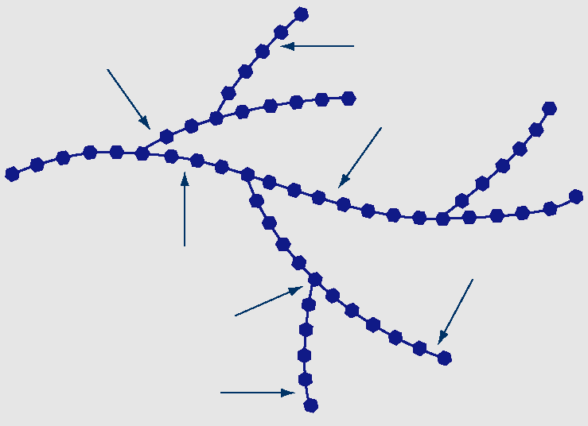
Amylases / Starch Acting Enzymes
Pullulanase
β-amylase
α-amylase
α-amylase
Amyloglucosidase
Pullulanase
Amyloglucosidase

Slide 9
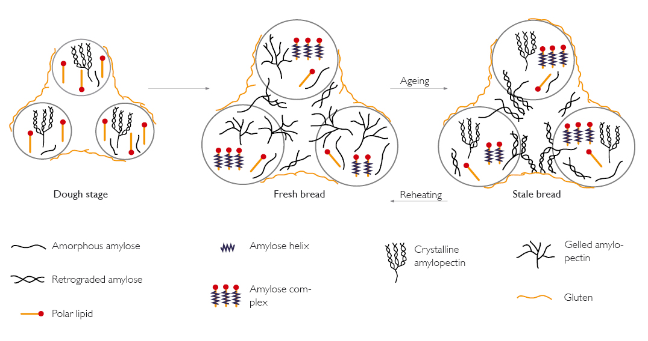
Amylases as Anti-staling Agent

Slide 10
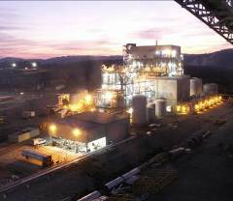
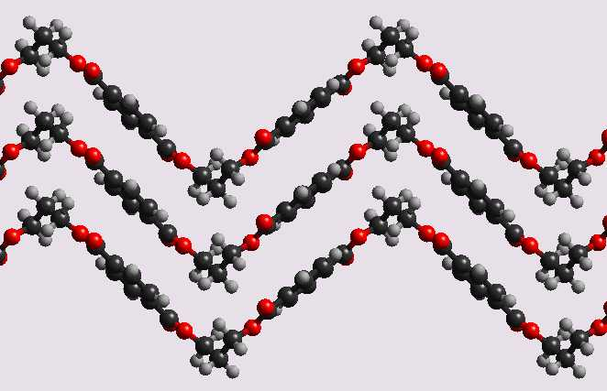
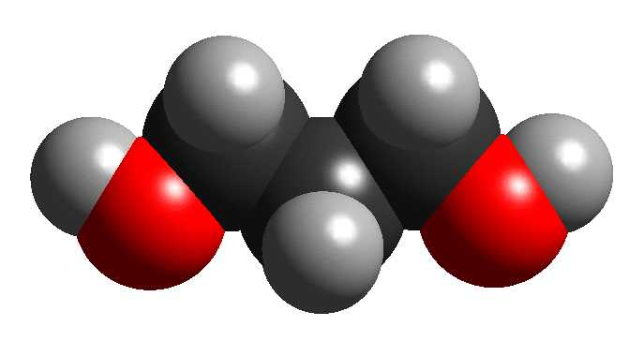
DuPont™ Sorona® Bio-Based PTT Polymer
Bio-PDO™
1,3-propanediol
+ DMT / TPA
Unique polymer with
versatile properties
37wt% renewable content
Catalyst
O
O
-(-C
C-OCH₂CH₂CH₂O)-
n
Sorona® polymer
PTT = Polytrimethylene Terephthalate

Slide 11

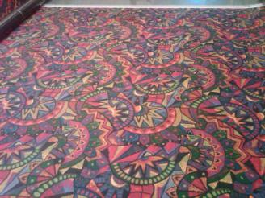


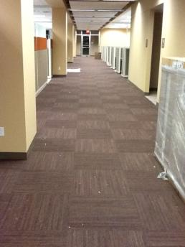

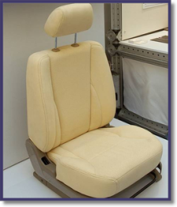
DuPont™ Sorona® - Carpet & Apparel Applications
Stain Resistance “Engineered Into” the fibers
Resiliency
Bright color & Infinite Color Choices
Superior Soft Touch
Bio-PDO™Strong Environmental Benefits
Residential Carpet
Commercial Carpet
Aotomotive Carpet Apparel

Slide 12

DuPont and Goodyear jointly develop BioIsoprene™ Process
Biomaterials
DuPont and The Goodyear Tire & Rubber
Company: an integrated process to,
manufacture BioIsoprene™ product at industrial scale
A collaborative research initiative
Joint multimillion-dollar investment
BioIsoprene™ product is a bio-based, renewable
alternative to the petroleum-based isoprene
BioIsoprene™ is a “business platform chemical”
DuPont will lead commercial development
Concept tire – not available to consumers
DuPont Confidential
17

Slide 13
A BioIsoprene™ Cell Factory
Conceptual View of the Isoprene Cell Factory
Glucose
C6 ►3C
(C5)
MEP Pathway
Sucrose /
Biomass
Isoprene
Synthase
Isoprene
Recovery
3C ►2C
Cells
Glycerol
16C ►2C
MVA Pathway
Plant Oils
Multiple feedstocks possible
Two feeder pathways to isoprene precursor
Isoprene synthase
Notes:
Increasing importance
These accomplishments give us confidence that:
1. For MVA we can continue our cycle of fermentation – analysis – improved construct – improved fermentation. Throwing all our might at MVA is inefficient, since at this point our improvements come in response to the fermentation, not from trying every possibility
2. That high productivity isoprene production follows rules and is reasonably well behaved. We can push the system harder and set higher goals than just making the easiest chemistry work.

Slide 14
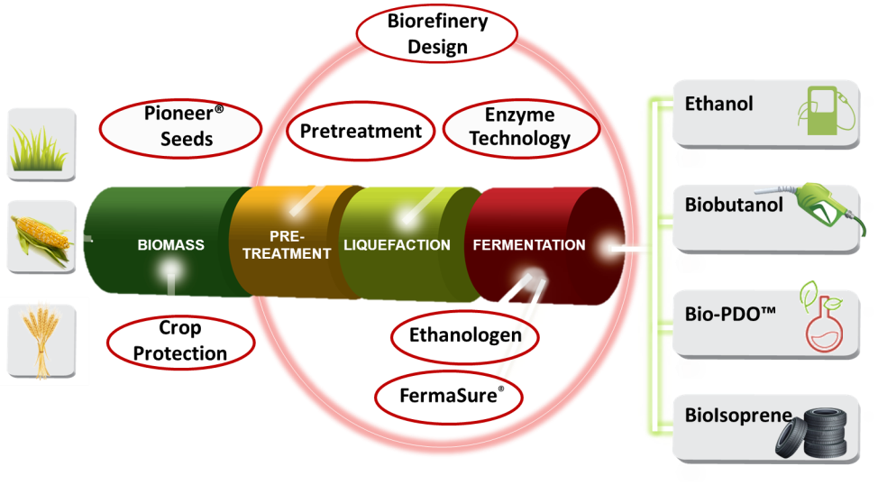
Enabling the Biochemicals & biofuels industries through our unique expertise
Notes:
The combination of DuPont and Genencor yields an unmatched portfolio of capabilities
Bio-PDO – Sorona, and our DDCE JV are great examples of combining Genencor and DuPont expertise. It’s now used in carpet fibers, personal care products and other applications.
Our aim is to address the most pressing needs across a broad spectrum of industries and value chains – and now as DuPont, we have a very broad spread of expertise to address these challenges
There is a strong need for a holistic, collaborative approach cutting across Industry, Policy and Science stakeholders to enable a biobased economy.
We must work together across the value and supply chain:
Cultivate steady supply of renewable feedstock
Develop infrastructure: from farm to factory …
Build cell factories and biorefineries
Develop and secure responsive distribution channels
Both at Genencor and DuPont, we believe a biobased economy is a viable option and is already on its way – not only because we deliver solutions for it today, but also because we believe we are only starting to scratch the surface of what is possible. Together we can accomplish what can’t be done alone.

Slide 15
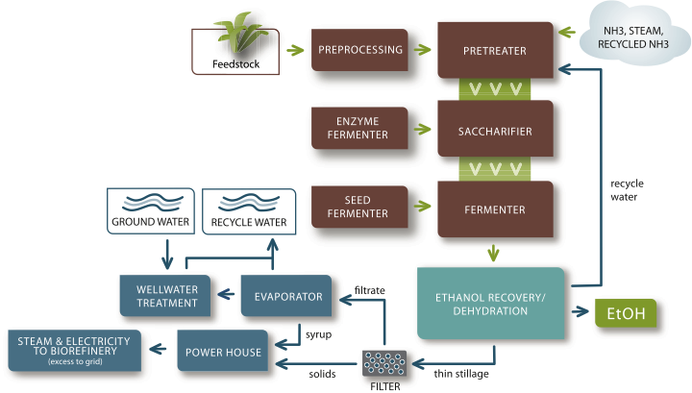
The Overall Design of the CE Biorefinery

Slide 16
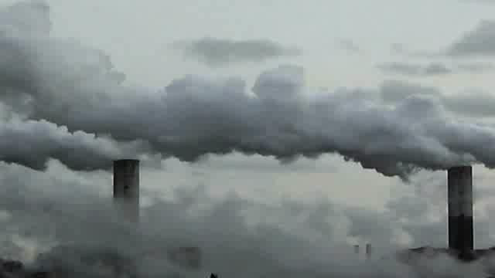
An Expanding Need for Industrial Biotechnology
We are living in an age of climate change and environmental decline.
  The earth is warming.
  Clean air and water are becoming more scarce.
  Fossil fuel demand is increasing and its use is accelerating climate change.
Notes:
Pond5 videos: traffic jam, water pollution, air pollution

Slide 17


One Idea: GNext
An open innovation engine designed to help companies developing solutions for air, water and bio-energy.
Leverages Genencor’s core competencies in the discovery, engineering, production and supply of enzymes, proteins and microorganisms – at large-scale and a low price-point.

Slide 18





Addressing society’s big needs
Improving air quality
Cleaning the Air
Preventing Pollution
Clean water for everyone
Potable, Industrial or Agriculture Water
Pollution prevention or remediation
Sustainable bio-energy
Affordable energy
Sustainable energy
Secure

Slide 19

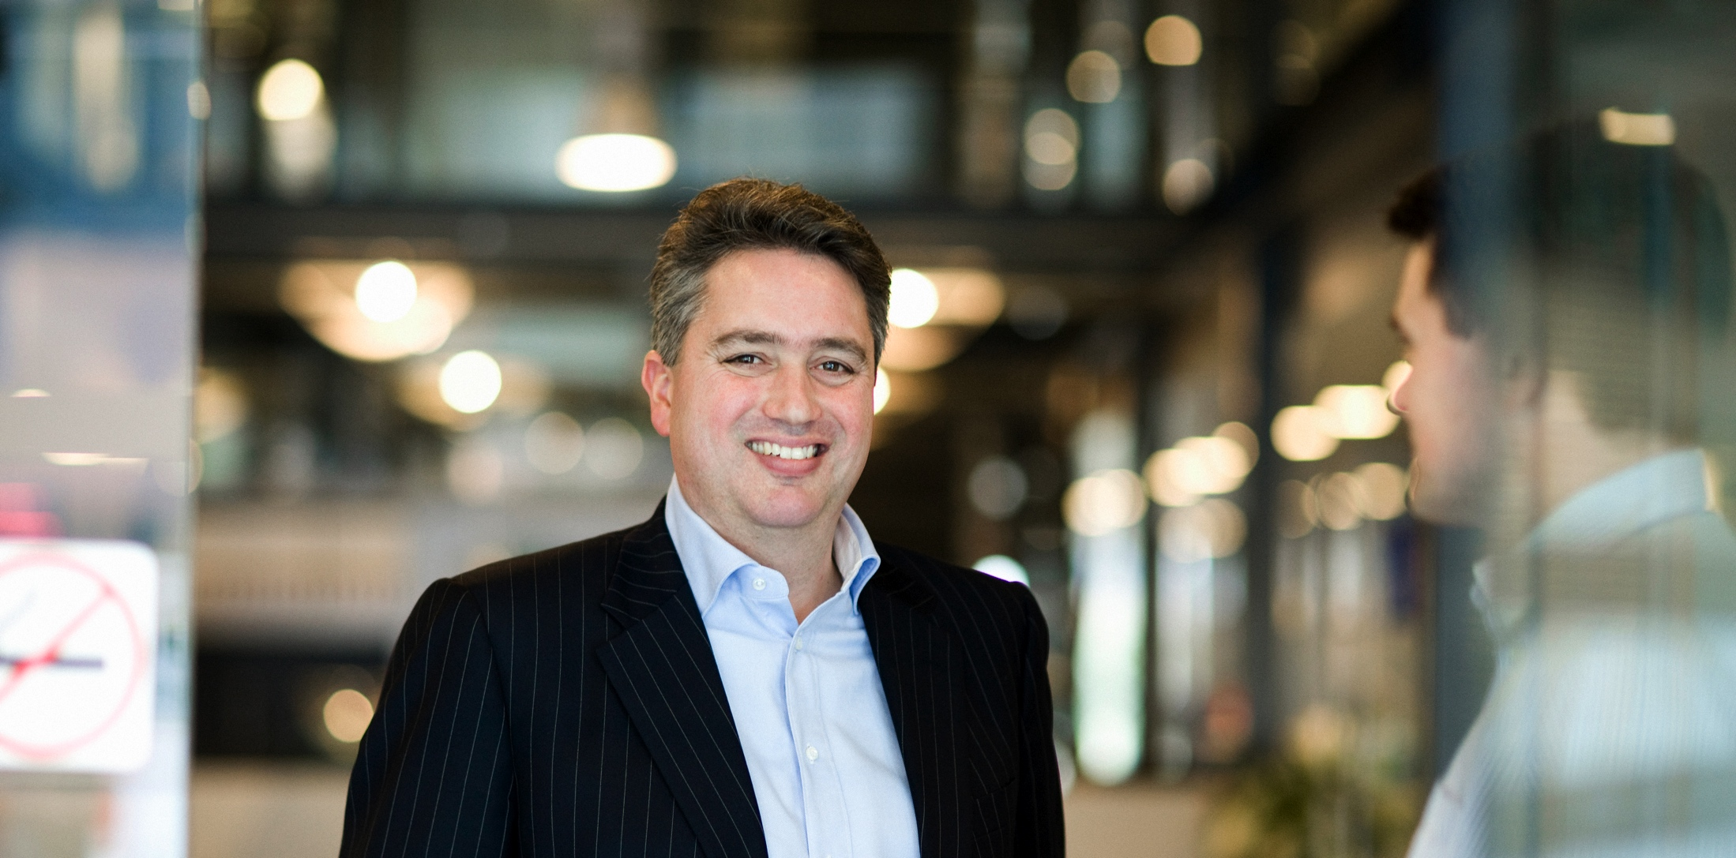
Who should partner with us
One
Two
Three
If you are developing a solution for air, water or bio-energy.
And require an enzyme, protein or microorganism as key element of that technology.
Talk with us.

Slide 20
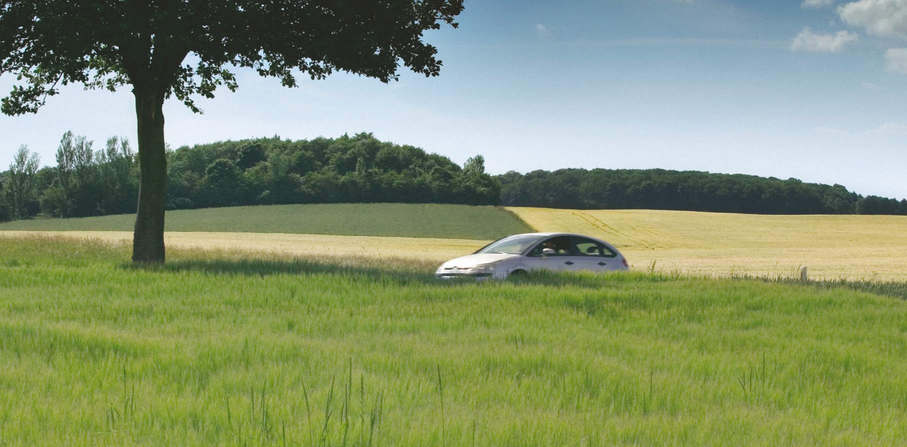
Together we can accomplish what can’t be done alone. Thank you.
gnext.genencor.com | gnext@danisco.com

Slide 22

W
Nutrition & Health: Business Opportunity
Food
Health
Sustainability
  Need to increase food supply significantly
  Rising raw material prices
  Need for affordable and sustainable food
  Trend for natural, clean label product
  Twin challenges of obesity
  and aging
  Chronic disease
  Food safety and pandemics
  Demand for healthy foods
Nutrition
Safety
We will be the premier specialty food ingredient and food safety leader
22
Notes:
22

