Slide 1
Translating Your Credentials: Turning Your CV into an Effective Resume & Enhancing your LinkedIn Profile
Andrew Green, PhD
PIEP – February 2, 2015

Slide 2
Bridging the Gap Between Academia and Industry

Slide 3
Our Site Visits
Our Workshops
Persuasion: Communications and Sales Skills for PhDs
Employees in Early Start-ups
Careers in Intellectual Property
Company Info Sessions
Thanks to the UC Berkeley Vice Chancellor for Research, Career Center, Industrial Alliances Office, and Visiting Scholars and Postdoctoral Affairs Office for funding and support.

Slide 4
website: http://piep.berkeley.edu
subscribe: piep@lists.berkeley.edu
We are recruiting new members – email us !
ucb.piep@gmail.com
Our upcoming site visits:
March 6
April 7

Slide 5
Translating Your Credentials: Turning Your CV into an Effective Resume & Enhancing your LinkedIn Profile
Andrew Green, PhD
PIEP – February 2, 2015

Slide 6
Last week, I had an appointment with an MCB Postdoc
1st Question – Have you already submitted this resume and/or cover letter?
2nd Question – How well do your scientific credentials map to the job description?
In this instance not very well, but it was not a pure bench role
What did he give me?
Two documents that highlighted the gap between his specific credentials and what the job description called for
What was our goal?
Documents that addressed the overarching qualifications of the job posting rather than speak to the specific bullets

Slide 7
The specific focus of this presentation is the resume and cover letter. But it’s really about the broader challenge of how you translate your skills, interests, and experience into a package that readily conveys your appeal to potential employers.

Slide 8
Too Often PhDs & Postdocs
Deem These Truths to be Self-Evident
Don’t Understand the Logic and Constraints that Hiring Managers Operate Under:
Time is Scarce (3.7 sec scan)
Your Audience Feels Overburdened
They are Risk Averse - Will Hiring this Person Make Me Look Stupid?
Why is Someone Who Spent 6 Years Getting a PhD Sitting in My Office?
Your Job is to Make it Easy for Them and Alleviate their Concerns

Slide 9
I’m a hiring manager or a member of a hiring committee.
My job is to narrow down the list invitees
Am I going to devote a whole afternoon to the task?
What am I interested in? What is my mental checklist?
Most documents I see are written from the inside out.
You want your resume and cover letter to be written as a response to what your audience cares most about

Slide 10
Andrew E. Green
11 Winchester Road
New London, CT 06320
(860) 439-2011
PERSONAL
Born: February 13, 1958 in Providence, Rhode Island
U.S. Citizen
Married
EDUCATION
Ph.D. University of California, Berkeley,
December 1993 (Political Science)
M.A. University of California, Berkeley,
May 1987 (Political Science)
B.A. Occidental College, Los Angeles, California
June 1980 (Economics)
DISSERTATION
Creating Comparative Advantage in a Changing International System: The Development of the South Korean Automobile Industry
PROFESSIONAL EXPERIENCE
Assistant Professor, tenure-track, Connecticut College, Government Department (beginning Fall 1991). Teaching courses in International Relations, Japanese Politics, The Political Economy of the Pacific Rim, International Political Economy, and Methodology.
Notes:
Notice all the illegal information

Slide 11
ANDREW E. GREEN 821 Cornell Avenue Albany, CA 94706 (510) 558-1597
aegre58@aol.com
Objective: Position as Student Affairs Officer II - Career Center #02-310-30/SS
HIGHLIGHTS OF QUALIFICATIONS
Have experienced both sides of the academic job market.
Have worked in and hired for non-profit organizations.
Advised students, and non-profit & public policy professionals.
Have planned and organized large and small-scale seminars and colloquia.
Experienced speaker before small groups & large, and published writer & editor.
PROFESSIONAL EXPERIENCE
AIDS Vaccine Advocacy Coalition, San Francisco, CA 1997-Present
Policy Analyst/Writer for annual report on progress towards an AIDS vaccine.
Connecticut College, New London, CT 1991-1997
Assistant Professor, Government Department,
Specialized in counseling/advising foreign and non-traditional students, and students at risk.
Served on six faculty search committees.
Assisted in screening candidates for national fellowship competitions.
Information Technology Committee member.
Published research & taught courses on Asian development and international political economy.

Slide 12
CV => Resume
What do I see 90% of the time after a person’s name and contact information?
What Should I see?
Resume has Two Functions: One Internal & One External
There is no Recipe or Formula, But There is a Logic

Slide 13
Key Issues
Understanding the sources of your value – Speed Dating (project vs. skills)
Breaking down your contributions
Translating your credentials
Anticipating their key concerns; Showing not telling
Go beyond a laundry list; what is the yield
First impressions matter

Slide 14
If you’re in the sciences and interested in a research position, ask yourself:
Does my current of former PI have “name brand” recognition?
Do they care about the substance of my research OR the lab, instrumentation, software skills I’ve developed working on that and other projects?

Slide 15
If your interested in a non-bench role, ask yourself
What do you want them to know about you?
How do you convey skills in administration, project management, communication, etc.
Don’t tell, show.

Slide 16
The importance of appearance
2009-present Postdoc in Biochemistry, University of California, Berkeley, The biochemical mechanisms of Lyme disease in ferret-type animals, Ikura Wasabi, Examination Fields: Biochemistry and Molecular Genetics
2004-2009 PhD student in Chemistry, Tehran University of Medical Science, Genetics of cute Dogs, E. Barry Keehn

Slide 17
EDUCATION
Postdoc University of California, Berkeley
Immunology, 2012 - present
Advisor: Alan Jose
PhD University of Rhode Island
Comparative Biochemistry, May 2012
Advisor: Linda Ryan
The biochemical mechanisms of Lyme disease in ferret-type animals
BS Sacramento State University
Molecular and Cellular Biology, May 2007
Magna cum laude

Slide 18
Graduate Students & PhDs, and Postdocs Have a lot of Skills
Research
Analytical
Communication
Entrepreneurial
Teaching/Mentoring
Collaborative
Inter-Personal

Slide 19
But You Need to Articulate & Translate Them
From:
Teaching Assistant Bio-1A
To:
Experience Explaining Complex Concepts to Non-Expert Audiences
Comfortable Speaking Before Large & Small Groups
Trained in Assessment, Coaching, and Mentoring Skills

Slide 20
Or
GSR – UC Berkeley
Assisted faculty member in the preparation of manuscript for publication
Editorial Assistant – UC Berkeley
Assisted faculty member in preparation of book-length manuscript subsequently published by University of California Press
Line edited, copy edited, and indexed manuscript
Consulted with production editor and proofread galleys

Slide 21
RESEARCH EXPERIENCE
Postdoctoral Researcher – Lawrence Berkeley National Lab June 2012-present
PI: Roger Boesche
Utilizing advanced techniques in thin film lithography generated novel designs that maximize photovoltaic yields
Utilized advanced CSM and LCSM techniques to characterize target molecules
Generated fast algorithms programmed in C to analyze experimental data leading to the identification of 4 novel, spatial arrangements
Initiated 3 interdisciplinary collaborations (1 multi-site) leading to 4 high impact publications
Organized lab start up, trained 2 graduate students and 3 undergrads, and wrote lab safety protocols

Slide 22
The sources of your value
Break down your roles and functions; have a friend interrogate you.
Postdoc – University of California, Berkeley
PI: Sam Castaneda, Rocket Science lab
Use Monte Carlo simulations programmed in C to calculate the impact of non-stochastic turbulence in re-entry trajectories
Develop fast algorithms to analyze postdoc funding in the year 2020 given a range of values associated with different rates of health insurance premiums increases.
Initiated inter-disciplinary, multi-site collaboration to analyze x
Led team in the creation and implementation of new lab safety protocols
Served as liaison to outside vendors
Trained and mentored 3 undergraduates and 2 graduate students
Selected to give presentations at 5 major, scientific conferences and to lay audiences at Cal Day and during visits to local area Middle Schools
Founding Member of the Postdoc Industry Exploration Program (PIEP) Advisory Board
Perform outreach to companies as potential host sites
Organize 8 week speaker series
Pay off speakers from VSPA slush fund

Slide 23
Potential Employers couldn’t see how my academic expertise transferred to the “real World...”
Gradually I figured out how to communicate with new co-workers, and let them see my skills on their terms.

Slide 24
The Four Basic Resume Formats
Chronological
Functional
Hybrid
Highlights of Qualifications

Slide 25
Specific Guidelines
Start with a Master File
Don’t Assert; Demonstrate
Be Concrete and Quantify Wherever Possible
Translate the Experience
Emphasize What “You” Did and Accomplished

Slide 26
Specific Guidelines
Don’t Undersell Yourself
Format and Order are Dictated by Relevance
Edit Ruthlessly; Leave Plenty of White Space
Never Smaller than 10 Point
It Speaks for You

Slide 27
Your Resume
A Targeted, Focused Instrument
Reflects the Job Description
Concise
Emphasizing Concrete Experience, Skills, and Accomplishments
Make it Easy for your Overburdened Audience
What Format Bests Matches my Credentials to their Requirements?
Three Second Test
Notes:
To understand why this is the case remember

Slide 28
This seems like a lot of work, why bother?
It’s about more than creating a document
It a process of pulling from your extensive inventory of skills and experiences
Focusing the readers attention on the specific sub-set of the above most relevent to their needs/decision
Translating and delivering that information in a clear and concise manner (whether in a cover letter, a resume, a LinkedIn profile, etc.) that helps them project you into the role for which you have applied

Slide 29
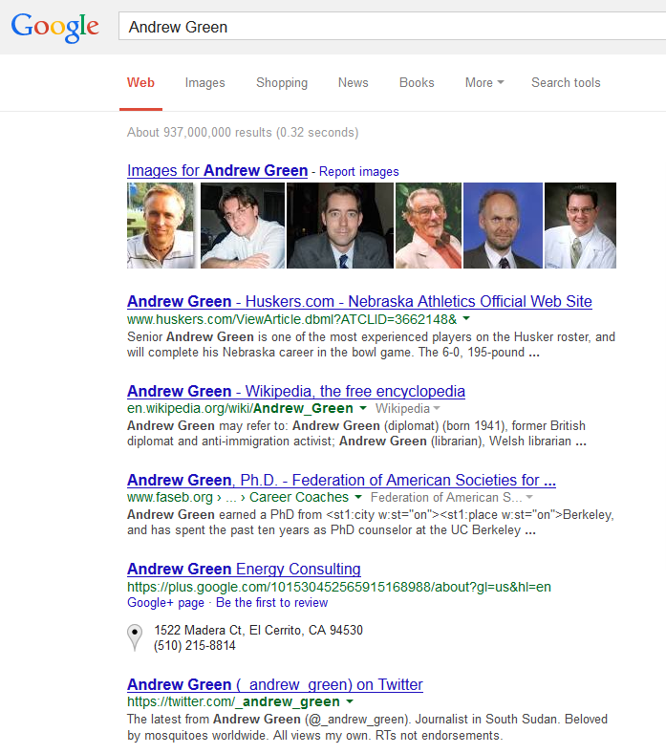
Expect to be Googled, and Use LinkedIn activity to boost your Google profile

Slide 31
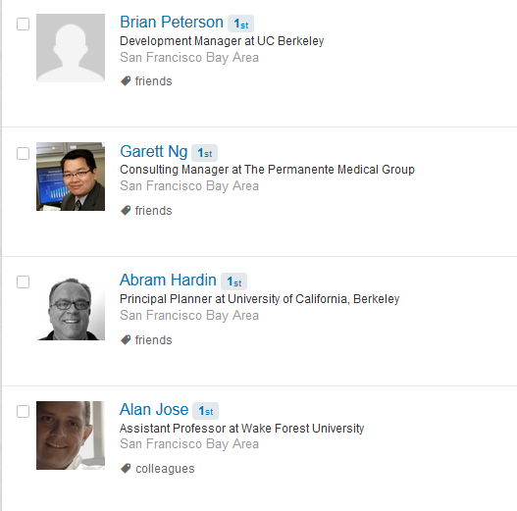
LinkedIn Profile
Profile with a photo is
11 times more likely to be
viewed

Slide 32
Professional Headline
Not just your title
Quant with five years of bioinformatics experience
Broadly trained biochemist with advanced skill in AFM
Postdoc with high level fMRI + Data Analysis skills
PhD with 5 years computational chemistry modeling and programming experience

Slide 33
Summary (30-50 words) - Should be forward looking
One of the nation’s leading PhD career advisors, Dr. Green has over 16 years of experience working with graduate students and postdocs at UC Berkeley. His specialty is working with PhDs and postdocs in the sciences pursuing professional opportunities in the business, government, and nonprofit sectors as well as those seeking academic jobs .
He has given invited presentations at major scientific meetings and research universities across the country; appeared in the Chronicle of Higher Education, NatureJobs, and The Atlantic Online; and is available to speak to small and large audiences alike on career development topics for graduate students and postdoctoral scholars.

Slide 34
Other Profile Tips
Utilize embeddable looks to showcase your projects, accomplishments and other professional aspects
Break up you experience into small digestible/glance-able bites (bullet points)
Turn off: publish changes to profile to connections
30 Day free premium trial

Slide 35
I see a lot of this

Slide 36
Lets make it bright and energetic

Slide 37
Questions?

Slide 38
Cover Letter
Introduction – Job Info & 3 Speed Dating Points
Body of the letter – Not a laundry list, relevant skills, highlight accomplishments & experience, and provide context & help them project you into the role
Conclusion – Source of your interest/motivation
1 page should do it

Slide 39
Anticipate their key concerns; Showing not telling
Do you play well with others?
How do your academic accomplishments carry over?
Can you make recommendations in the basis of partial data?

